Slide 1
Credential Verification
2025 Credential Verification Admin User Guide

Slide 2
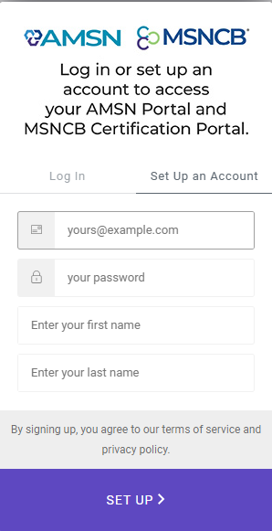
Step 1: Organization Account Creation
If your organization is a new Verifier member, you will need to create an MSNCB account and set up your organization by:
  Going to MSNCB.org and selecting: Create Account
  On the login page, select Set Up an Account
After creating your account and verifying your email, you will be asked enter your profile information.

Slide 3
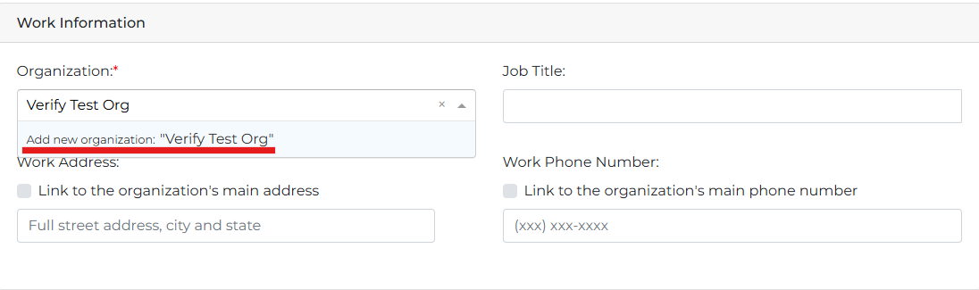
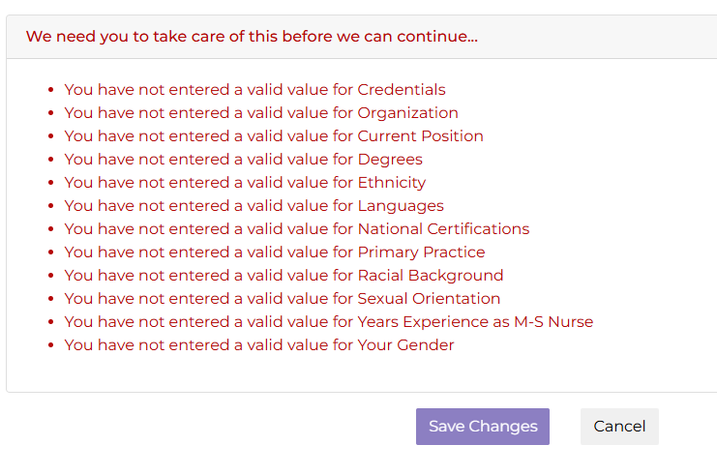
Step 1: Organization Account Creation (cont.)
Under Work Information, enter your organization’s name and select Add new organization
You may be asked to add additional demographics
  If none of these apply to you, please select any option as a selection is required
Save your changes at the end of profile information

Slide 4
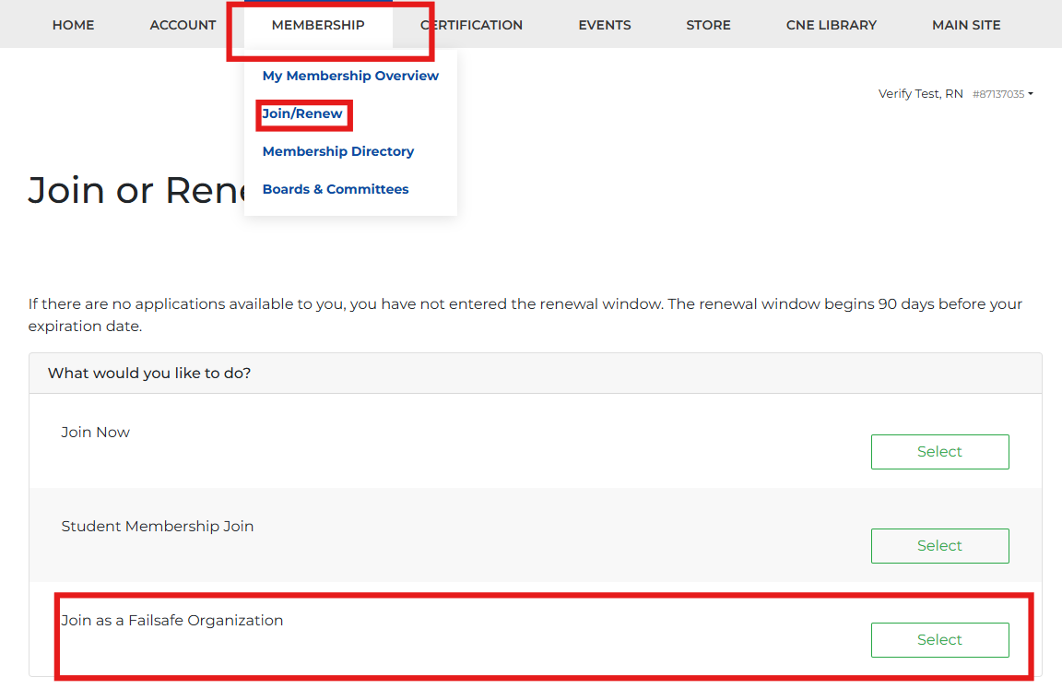
Step 1: Organization Account Creation (Cont.)
Once your account is created, you will need to join as a FailSafe member.
  This does not affect any credential verification
On your member portal, go to:
  Membership > Join/Renew > Join as FailSafe Org
  Follow the steps to complete the application. Payment is not required to submit your application
  Once you have completed the application, please contact us at msncb@msncb.org so that we may grant your FailSafe admin permissions

Slide 5
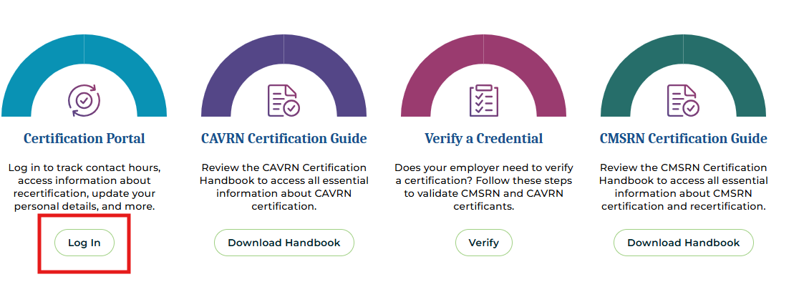
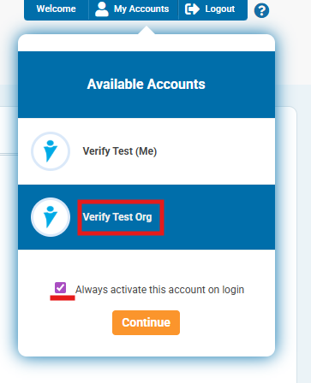
Step 2: Accessing Your Admin Account
Once the MSNCB team has granted your admin permissions, please log back in to your account at MSNCB.org and go to: Certification Portal
You will be required to select from two accounts:
  Personal or Organization
  Select the name of your organization you have set up

Slide 6
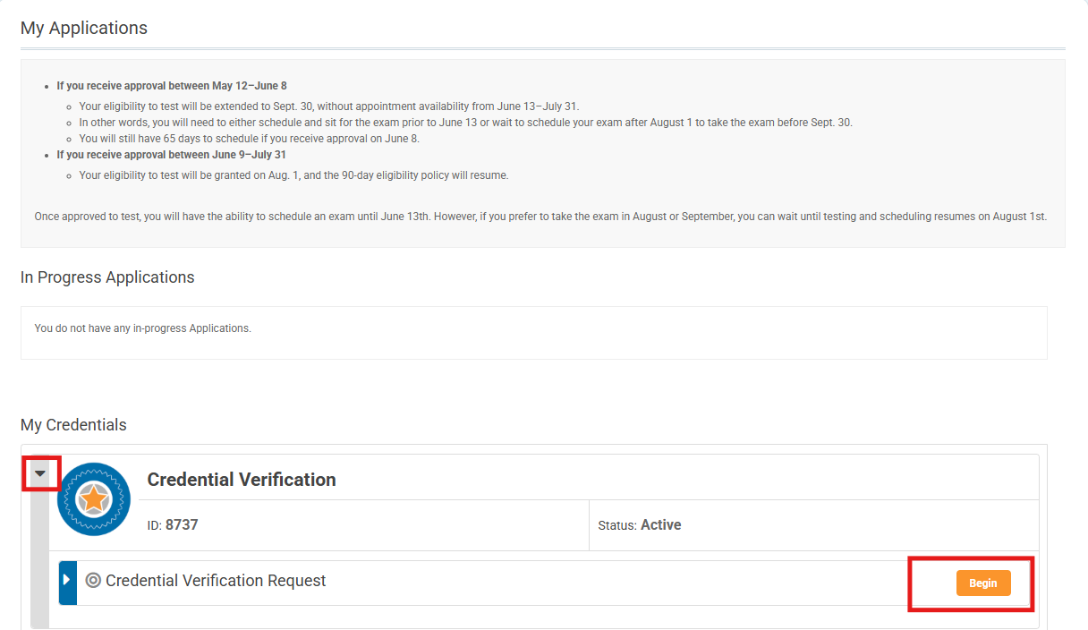
Step 3: Verifying a Credential
Once you are in your admin account, you can verify a credential by navigating to:
  Applications and click Begin
  You may need to click the drop down to see the credential verification application

Slide 7

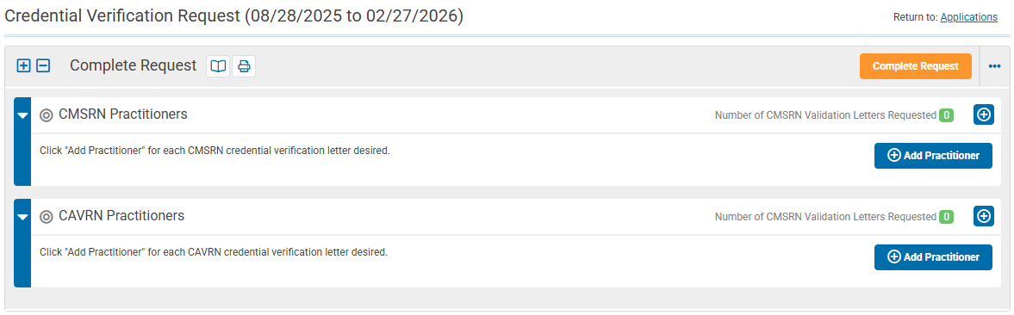
Step 3: Verifying a Credential (cont.)
Once on the application, you can find any active CMSRN or CAVRN certificants
Click Add Practitioner to begin searching for active certificants
Please Note: Credential Verification is only available for active certificants

Slide 8
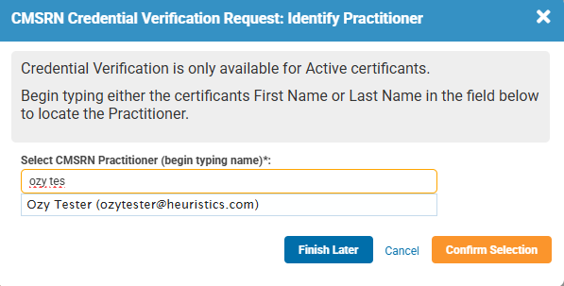
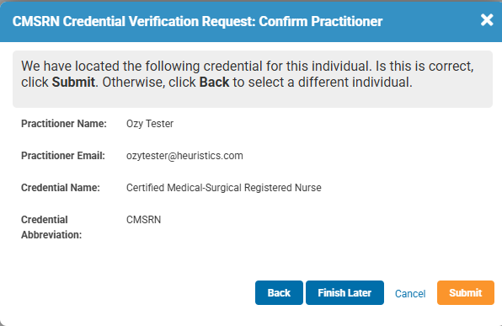
Step 3: Verifying a Credential (cont.)
If you cannot find an individual, they are either expired or not in our system and we cannot verify them
Please verify the certificants information
  Verify their first-last name
  The email address associated with their account
  The credential they obtained

Slide 9
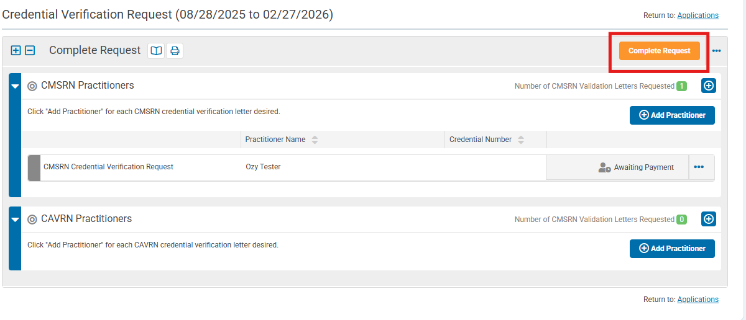
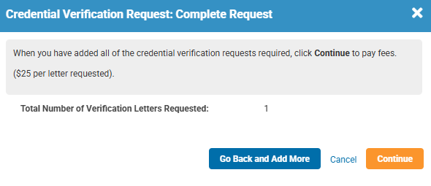
Step 4: Completing a Verification Request
Once you have selected the individuals you wish to verify, click Complete Request
  You may request multiple individuals for verification on a single application
Verify the number of verifications you wish to request

Slide 10
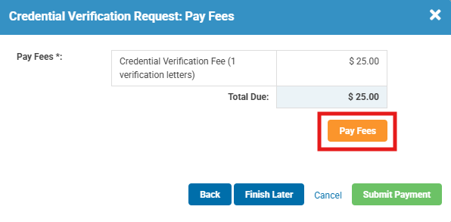
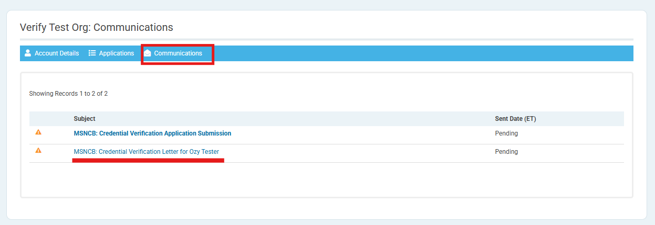
Step 4: Completing a Verification Request (cont.)
To receive the verification, please proceed to the payment screen by clicking Pay Fees
  Once paid, select Submit Payment
  Each verification request is $25
Once paid, you should receive an email with the verification letters you requested
  If not, you can always find the emails sent to you by going to: Communications

Slide 11
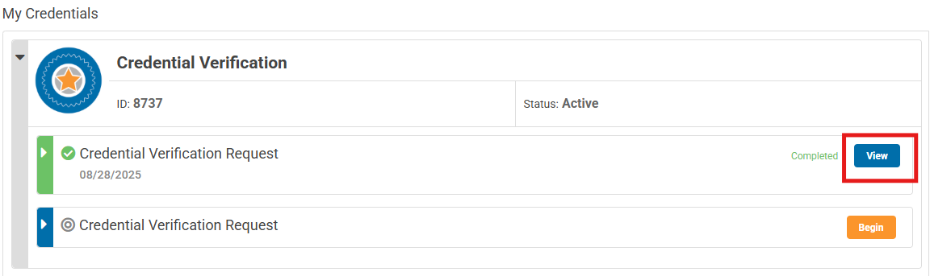
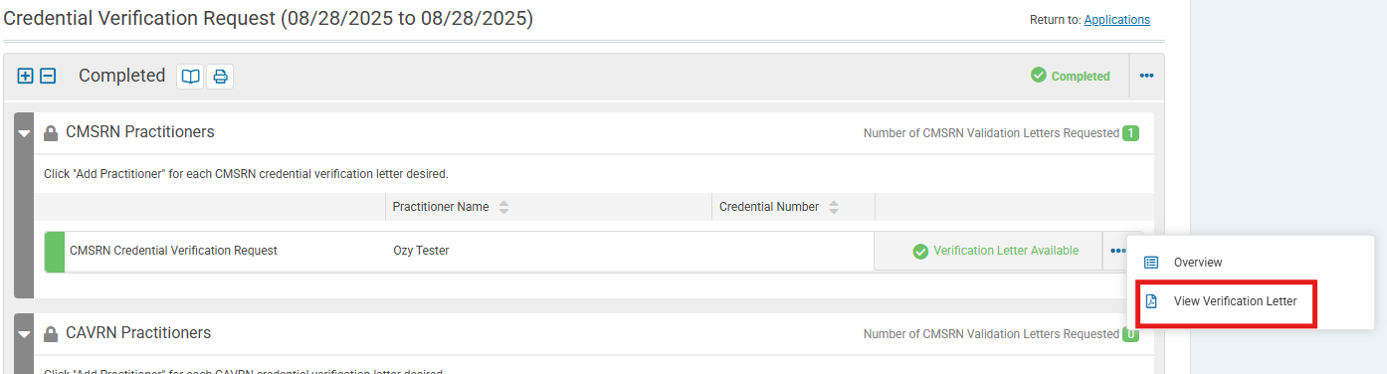
Additional Features
You can also find any previous verification request by going back to Applications and selecting View on any previous request
  Once on the old application, click the 3 Blue Dots and select View verification letter on any of the certificants you wish to redownload
Note: Most military emails do not accept automated emails with attachments or links
  If this is the case, please use these alternative methods to view your verification requests or please use another less restrictive email address

